Slide 1
ONLINE SHOPPING

Slide 2
DEPARTMENT OF COMPUTER ENGINEERING A.V. PAREKH TECHNICAL INSTITUTE (AFFILIATED TO GUJARAT TECHNOLOGICAL UNIVERSITY)
BY,
PARMAR MOHIT R. - 186020307080
PAUN KEVAL A. - 186020307085
RAITHATHA HEET N. - 186020307088

Slide 3
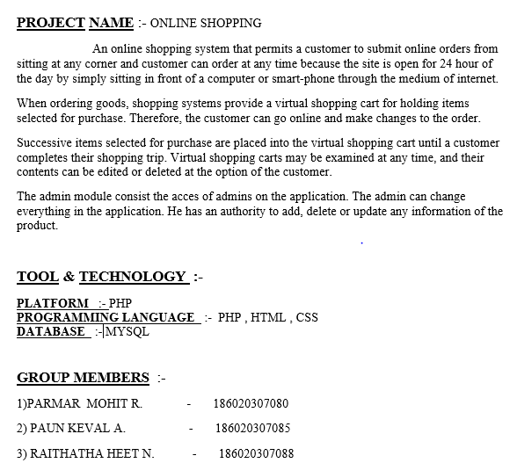
ABSTRACT

Slide 4
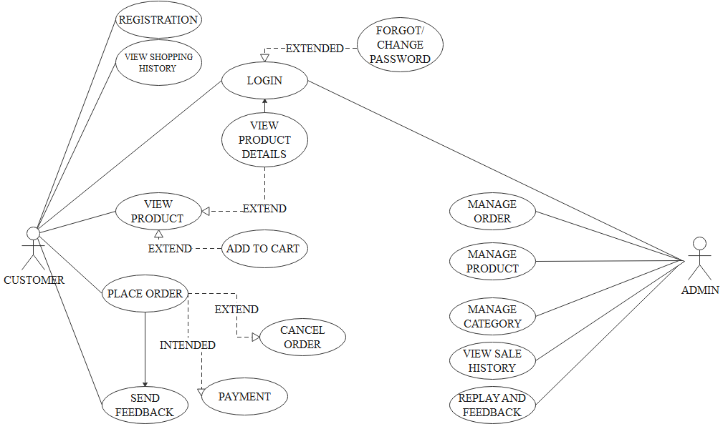
USE CASE DIAGRAM

Slide 5
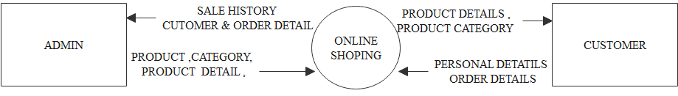
DFD DIAGRAM ( LEVEL 0 )

Slide 6
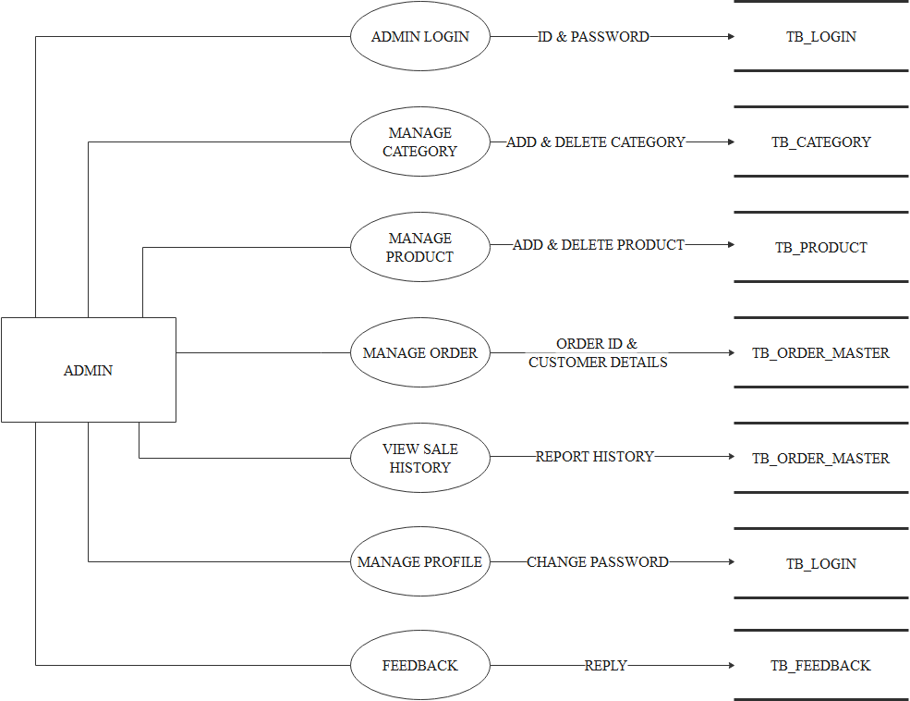
DFD DIAGRAM ( LEVEL 1 )
[ ADMIN ]

Slide 7
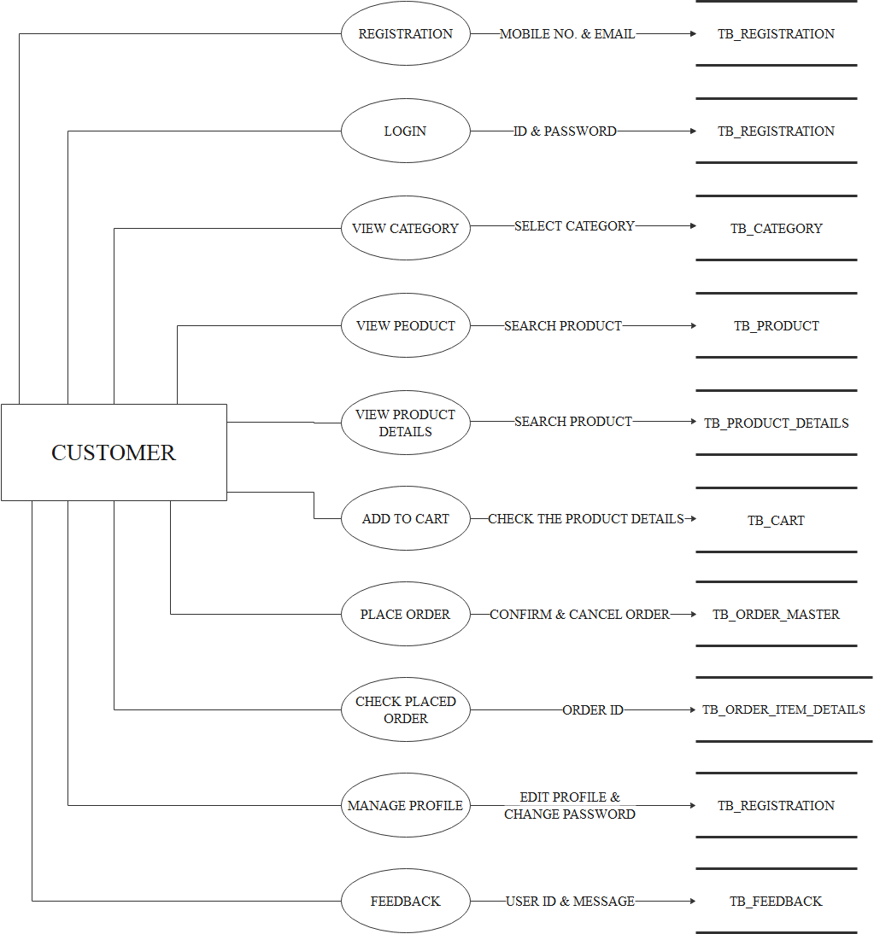
DFD DIAGRAM ( LEVEL 1 )
[ CUSTOMER ]

Slide 8
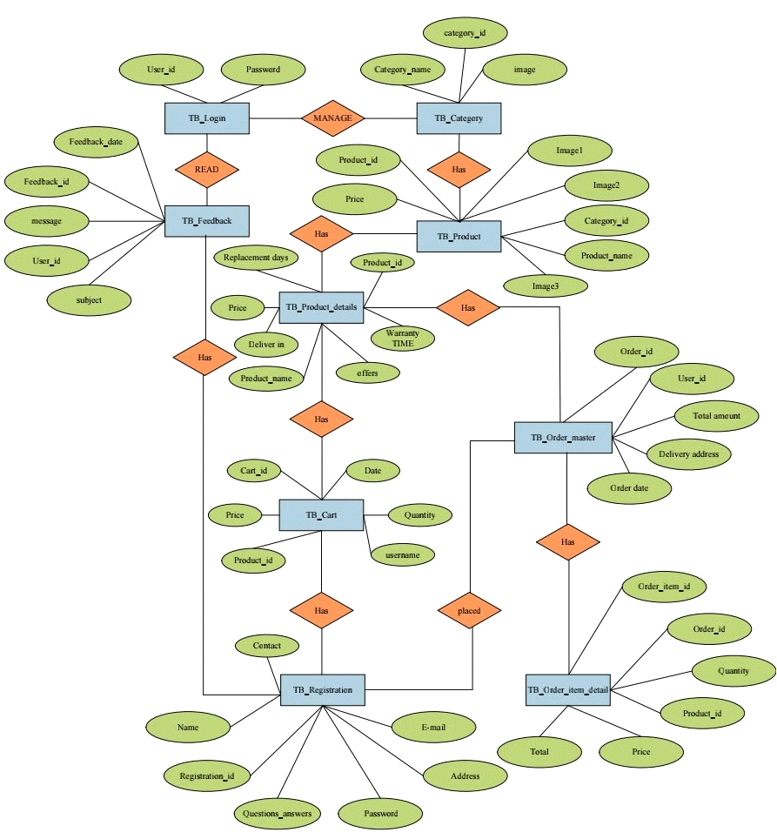
ER DIAGRAM

Slide 9
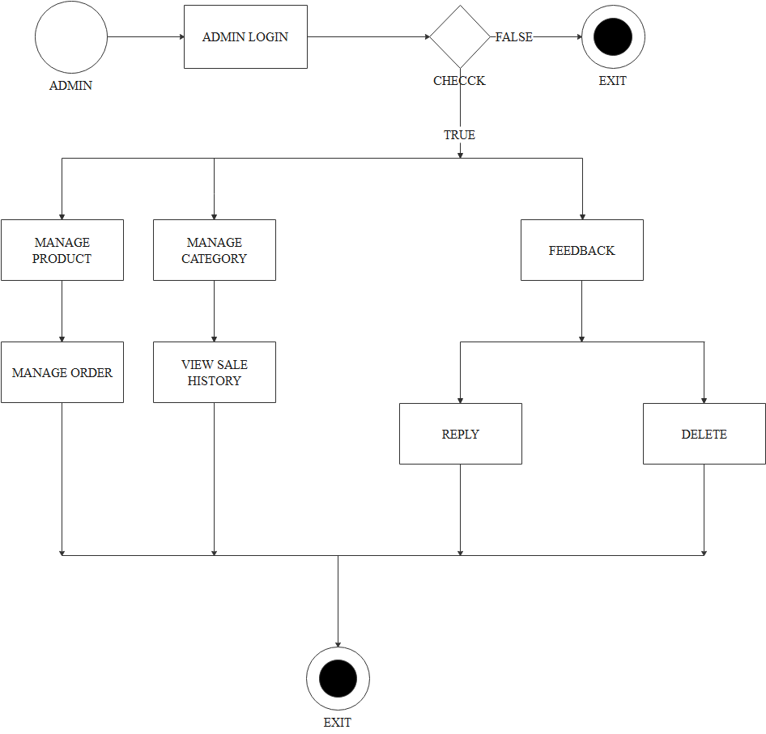
ACTIVITY DIAGRAM
[ ADMIN ]

Slide 10
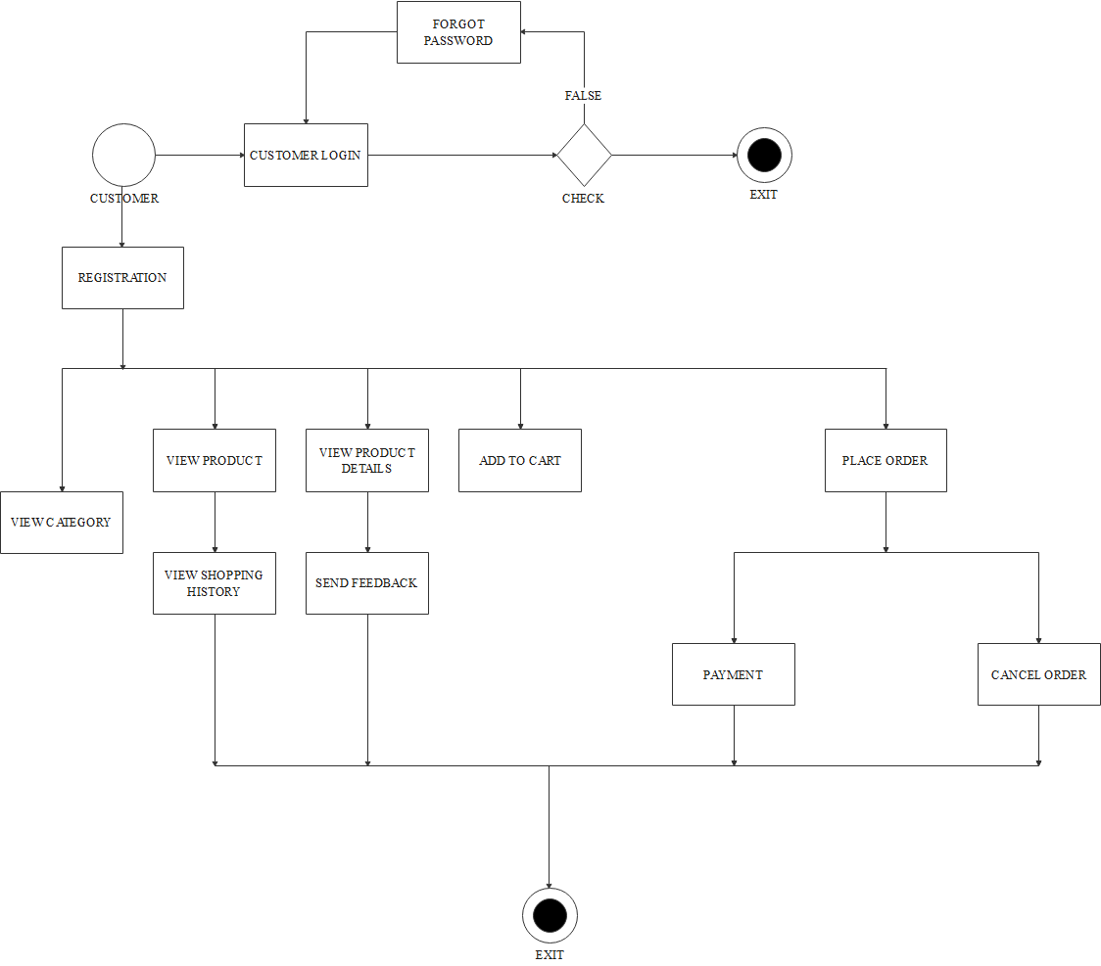
ACTIVITY DIAGRAM
[ CUSTOMER ]

Slide 11
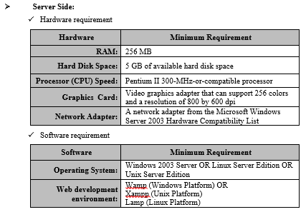
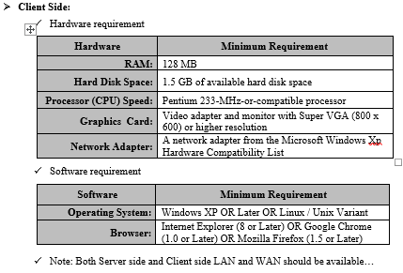
SOFTWARE AND HARDWARE REQUIREMENT

Slide 12
ADMIN PANEL

Slide 13
login.php

Slide 14
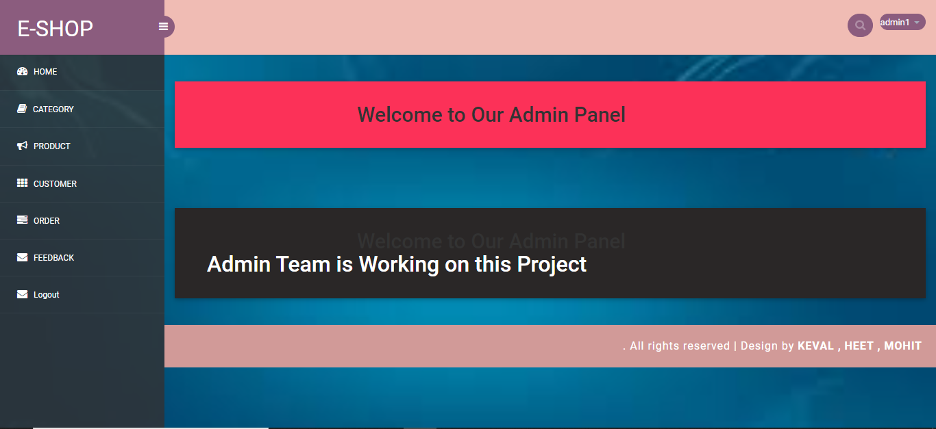
index.php

Slide 15
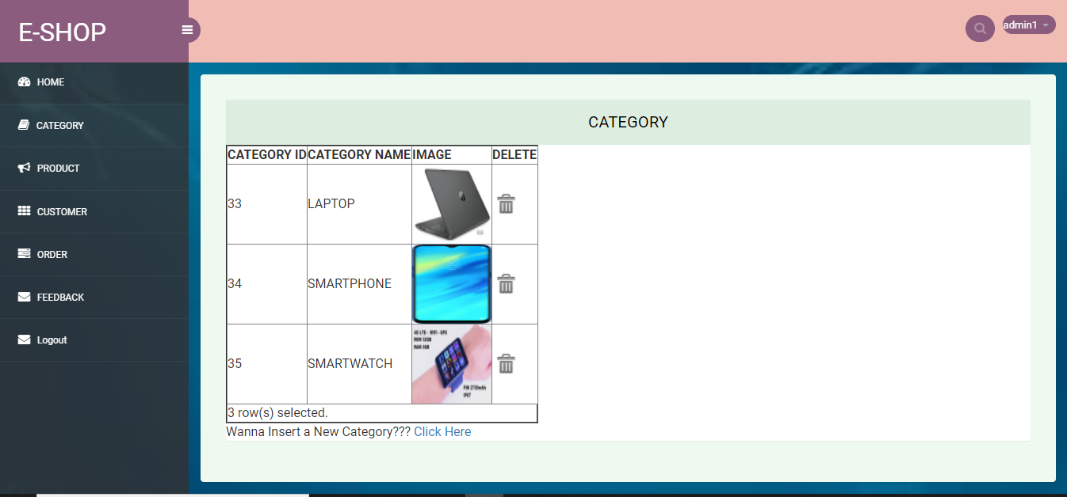
Category_details.php

Slide 16
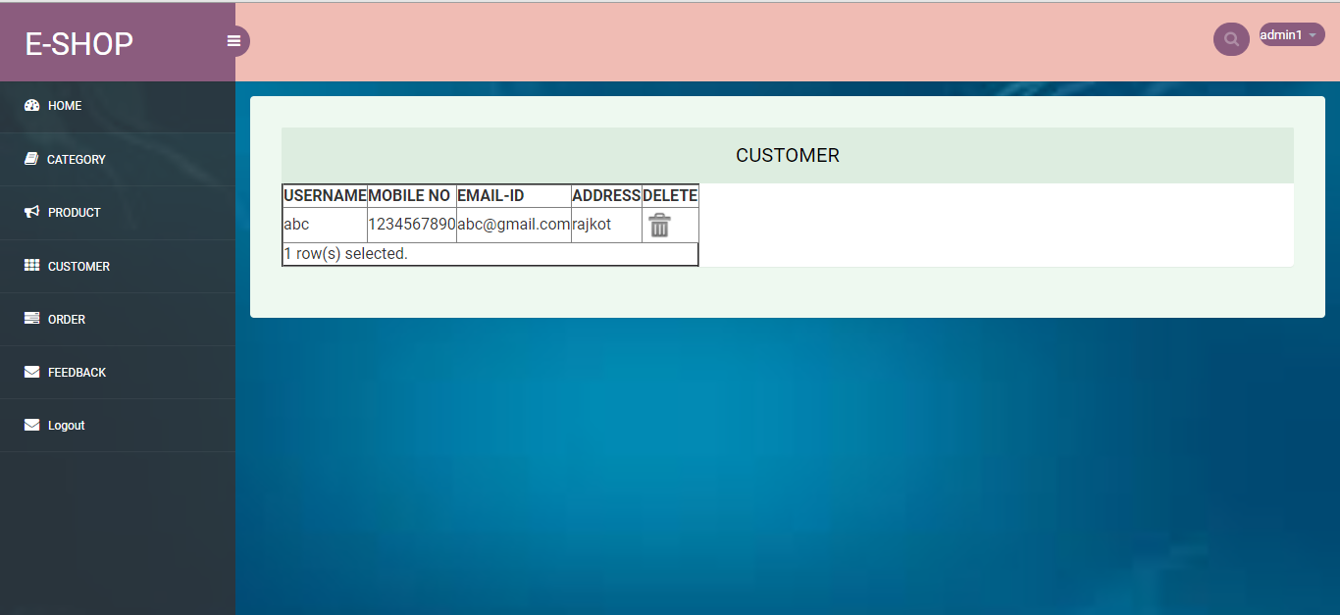
customer_details.php

Slide 17
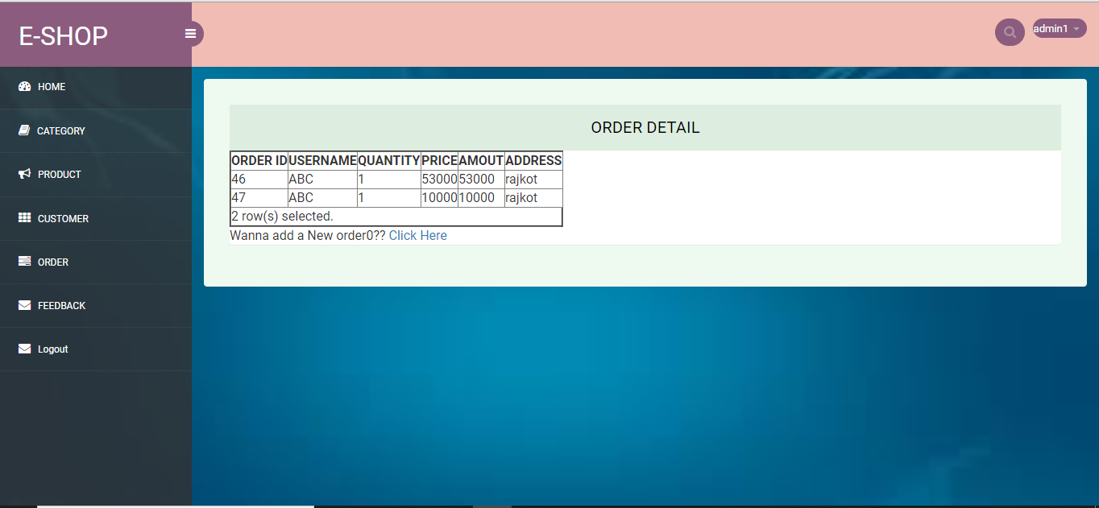
order_details.php

Slide 18
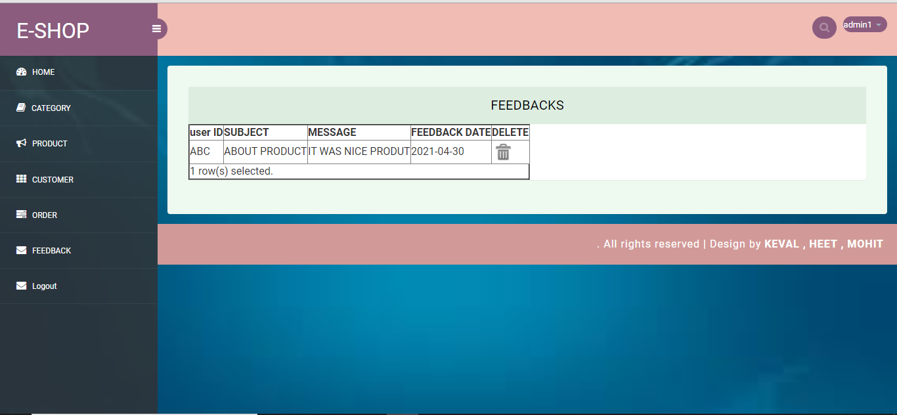
feedback.php

Slide 19
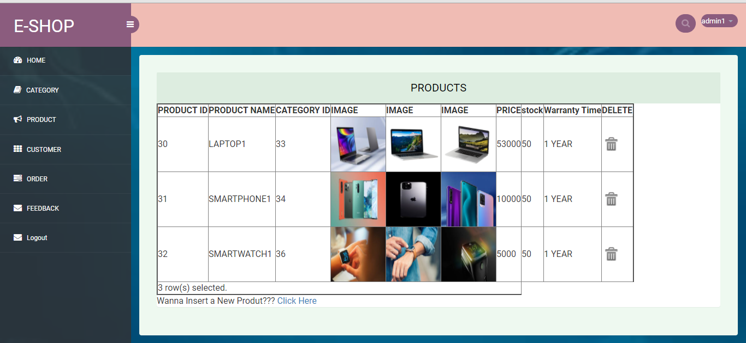
product_details.php

Slide 20
CUSTOMER PANEL

Slide 21
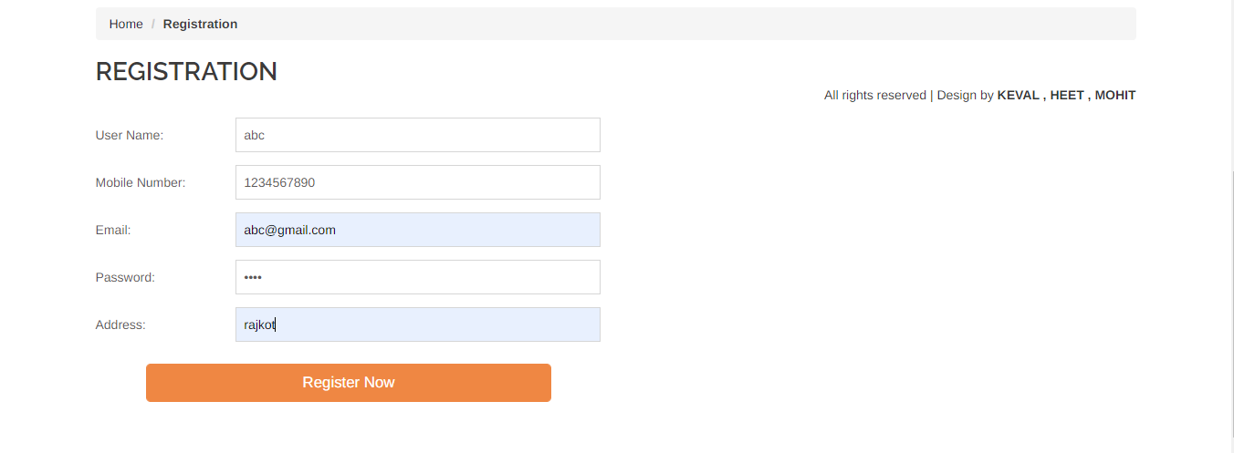
C_registration.php

Slide 22
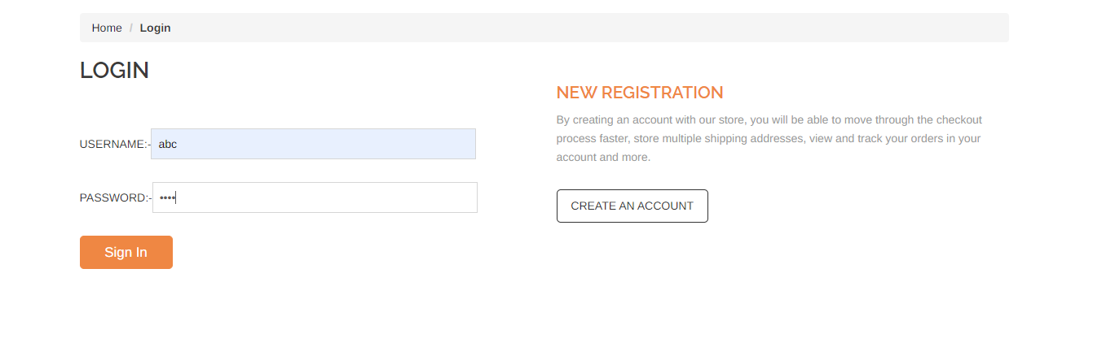
C_login.php

Slide 23


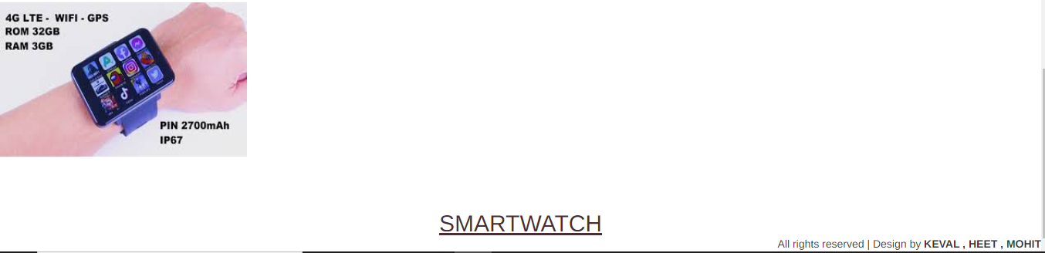
C_category.php

Slide 24

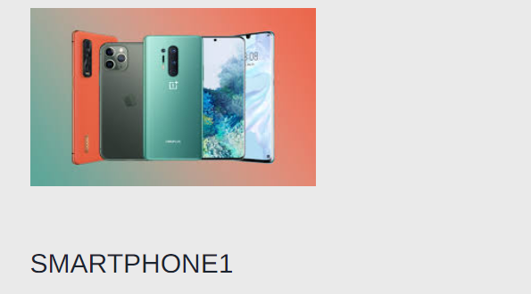
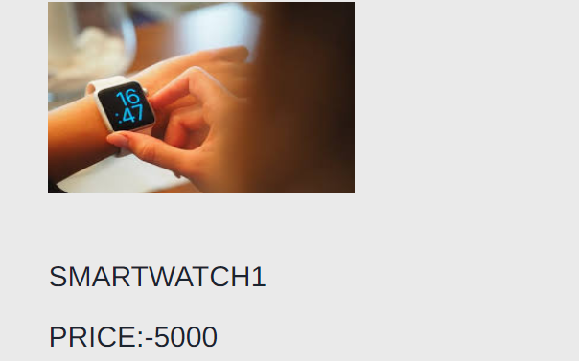
C_product.php

Slide 25
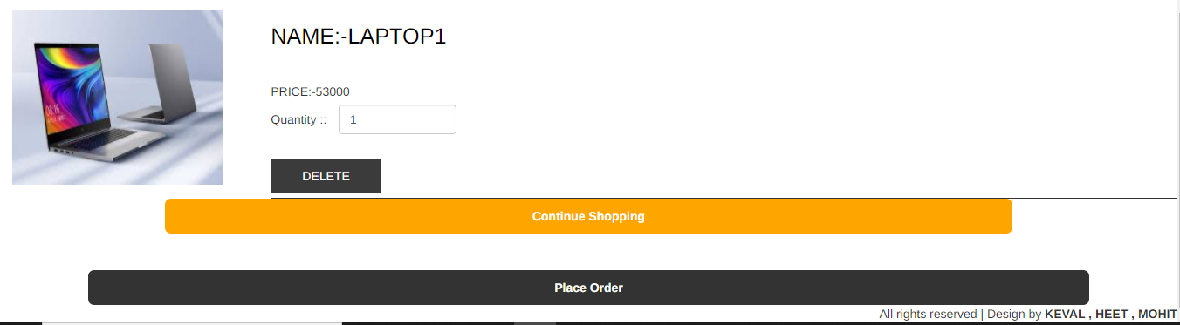
C_cart

Slide 26
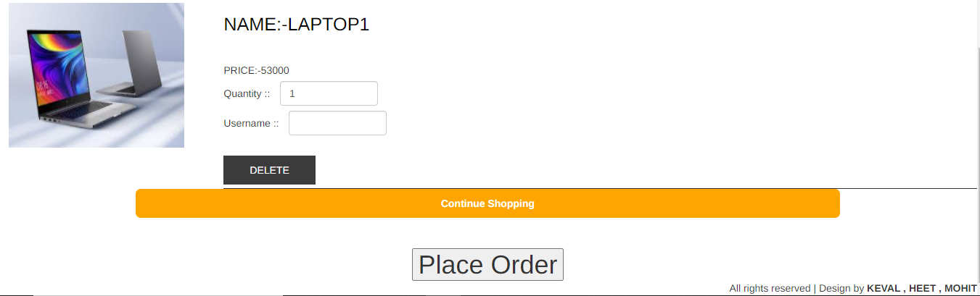
C_showcart.php

Slide 27
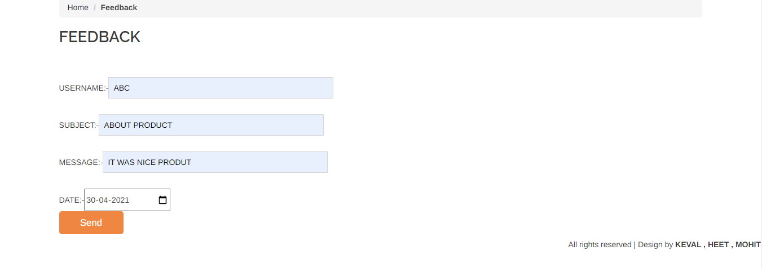
C_feedback.php

Slide 28
It's Currently not possible to import products from the other external programs.
It's Currently not possible That the customer can see their orders as per username.
It's Currently not possible to edit or cancel the order once it was placed.
It's Currently not possible to take online payment from customer.
LIMITATIONS

Slide 29
The enhancement that we can add the searching option. We can directly search to the particular product
We will Provide Online payment Facility.
We will provide a facility to edit or cancel the given orders.
We will provide an facility to see their own orders.
We will provide more user friendly layout to make easily usable by any user.
FUTURE ENHANCEMENT

Slide 30
BOOK REFRENCE
Mastering HTML, CSS & Javascript Web Publishing
BPB Publications
BIBILIOGRAPHY
BIBILIOGRAPHY
https://www.php.net/manual/en/langref.php

